Slide 1
Software Security Testing
by
Gary McGraw, Bruce Potter
presented by
Edward Bonver
11/07/2005

Slide 2
Security Testing Dilemma
QA is usually under pressure to complete the “feature test sets” (i.e. functional testing) (QA resources)
Budget and timing constraints
Security testing depends heavily on expertise and experience

Slide 3
“Choose Any Two…”
Usability
Security
Cost

Slide 4
Reactive vs. Proactive
Most defensive mechanism which “provide security” on the market do little to address the heart of the problem, which is bad security
They operate in reactive mode
Instead, in order to increase the levels of assurance of software security, we (software organizations, QA) need to be proactive

Slide 5
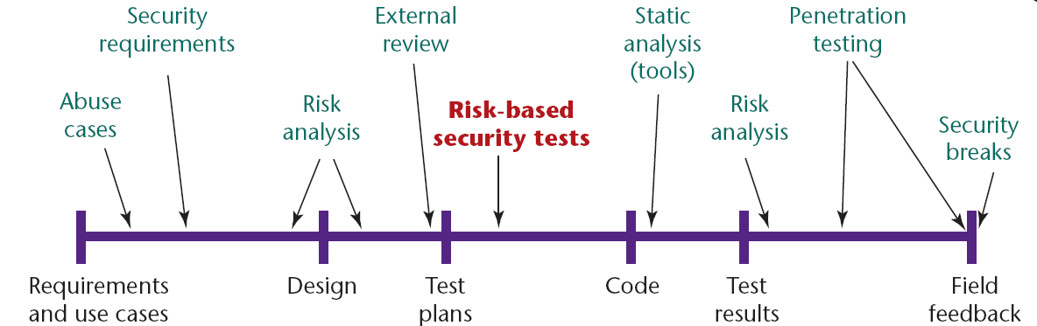
Software Development Life Cycle,
With Security In Mind

Slide 6
Microsoft’s Security Deployment Lifecycle Tasks and Processes
Security Training
Use Security
Development
Tools &
Security Best
Dev & Test
Practices
Create
Security
Docs
and Tools
For Product
Prepare
Security
Response
Plan
Security
Push
Final
Security
Review
Security
Servicing &
Response
Execution
Security Kickoff
& Register with
SWI
Security
Design
Best
Practices
Security Arch &
Attack Surface
Review
Threat
Modeling
Pen
Testing
Traditional Microsoft Software Product Development Lifecycle Tasks and Processes
Feature Lists
Quality Guidelines
Arch Docs
Schedules
Design
Specifications
Testing and Verification
Code
Signing A
Checkpoint
Express
Signoff
RTM
Product Support
Service Packs/
QFEs Security
Updates
Functional
Specifications
Development
of New Code
Bug Fixes
Requirements
Design
Implementation
Verification
Release
Support
&
Servicing
Source: Microsoft PDC 2005

Slide 7
What’s So Different About Security?
“Software security is about making software behave correctly in the presence of a malicious attack.”
“The difference between software safety and software security is therefore the presence of an intelligent adversary bent on breaking the system.”

Slide 8
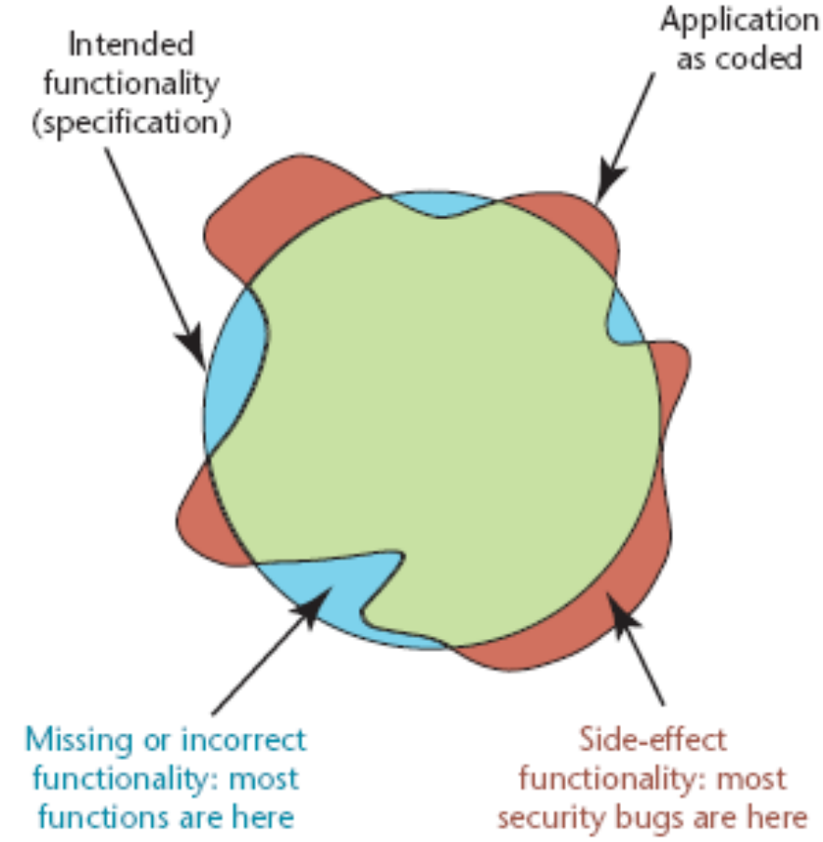
Intended Versus Implemented Software Behavior in Applications
Most security bugs lay in the areas of the figure beyond the circle, as side effects of normal application functionality
Source: Herbert H. Thompson, Security Innovation

Slide 9
Risk Analysis — It’s All Relative…
Information and services
being protected
Skills and resources of
the adversaries
Costs of potential
assurance remedies
Security

Slide 10
Conclusion
There is an absolute need for software security testing
Software security testing should be done proactively, and should be embedded into the software life development cycle
Software security testing is not easy – requires time, resources, experience and expertise

Slide 11
References
“Software Security Testing”, Gary McGraw, Bruce Potter, IEEE Security & Privacy, September/October, 2004, pp. 81-85
“Why Security Testing Is Hard”, Herbert H. Thompson, IEEE Security & Privacy, July/August, 2003, pp. 83-86

Slide 12
Questions
? ? ?
Go easy on me, too! ☺

